Slide 1
Go Workshop 3
Speakers:
Fernando Vargas Torres Roboam Casanova Castro

Slide 2


Fernando Vargas
Insert a high quality profile picture here
Software Engineer
Game Dev enthusiast
Likes surreal memes and C#

Slide 3

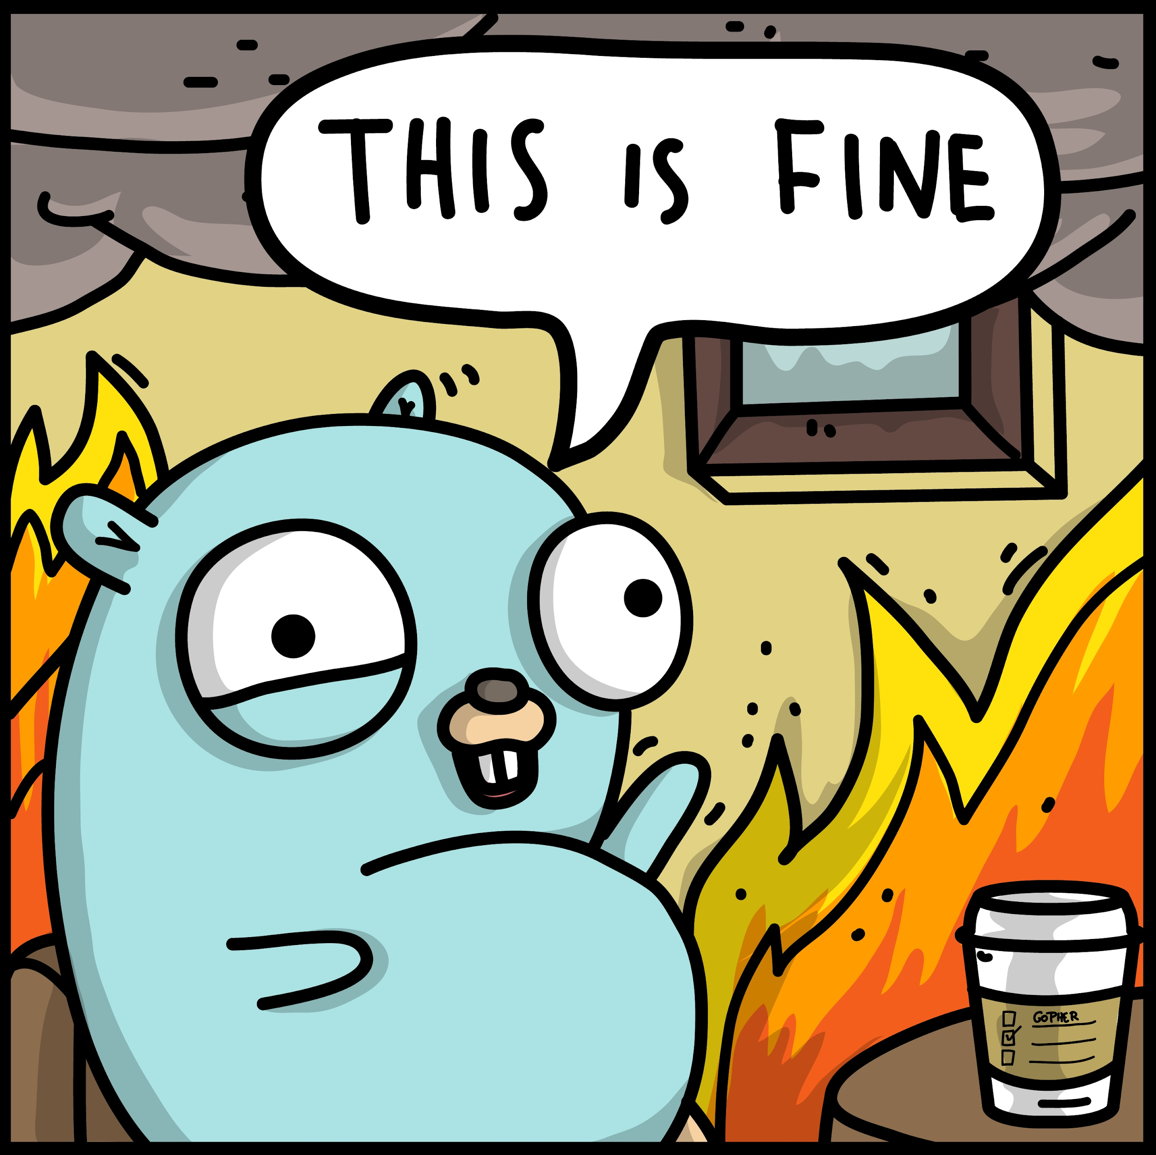
Roboam Casanova (AKA "Rollo")
Software Engineer - Go
3½ years doing Go stuff

Slide 4





Important Notes
Identify yourself in Zoom, using your name and last name
Mute your microphone along the course
Use the chat for questions during the Q&A sections
Focus your questions on the presented topic
Turn off your camera in case of connection issues
Notes:
These are notes primarily use for external events. Please, customize them accordingly to your needs.

Slide 5

Modules
Overview
Golang Types, Values, Variables and Constants
For Loops
Conditional statements
Multiple options conditional
Arrays and Slices
Architectures in Go
Maps
Functions
Structures
Error handling in Go
Pointers
Methods
Interfaces
Packages
Failed request handling
Modules
Testing (unit testing)
Go tools
Functions as values
Concurrency
1
2
3
4
5

Slide 6
Agenda - Important Dates
 | MONDAY | TUESDAY | WEDNESDAY | THURSDAY | FRIDAY
W1 | 15 Feb | 16 Feb | 17 Feb | 18 Feb | 19 Feb
 |  |  | Kickoff
W2 | 22 Feb | 23 Feb | 24 Feb | 25 Feb | 26 Feb
 |  |  | 1 / Workshop hour
W3 | 1 Mar | 2 Mar | 3 Mar | 4 Mar | 5 Mar
 |  |  | 2 / Workshop hour | First deliverable
W4 | 8 Mar | 9 Mar | 10 Mar | 11 Mar | 12 Mar
 | 1st Deliverable Feedback |  | 3 / Workshop hour
W5 | 15 Mar | 16 Mar | 17 Mar | 18 Mar | 19 Mar
 |  |  | 4 / Workshop hour | Second deliverable
W6 | 22 Mar | 23 Mar | 24 Mar | 25 Mar | 26 Mar
 | Holiday | 2nd Deliverable Feedback | 5 / Workshop hour
W7 | 29 Mar | 30 Mar | 31 Mar | 1 Apr | 2 Apr
 |  | Third deliverable | 3rd Deliverable Feedback
W8 | 5 Apr | 6 Apr | 7 Apr | 8 Apr | 9 Apr
 | Final Deliverable (3rd+feedback applied) |  | Demo Session + Closing

Slide 7
Pointers
Methods
Interfaces
Packages
Challenge
Q&A

Slide 8
Pointers

Slide 9
First, what is a variable again?
A variable is a name we give to a memory location were a value is stored.
var num int
name
100
value
0x0201
address
Notes:
Memory addresses are represented in Hexadecimal form

Slide 10
Ok so… what is a pointer?
A pointer is simply a variable that contains the memory address of another variable.
var numP *int = &num
name
0x0201
value
0x0202
address
Notes:
The & operator returns the memory address of its operand

Slide 11
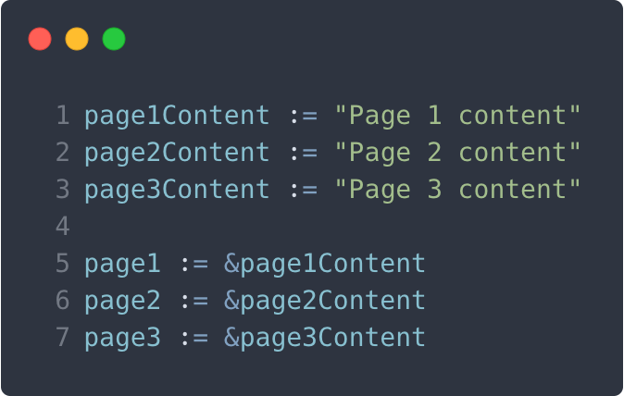
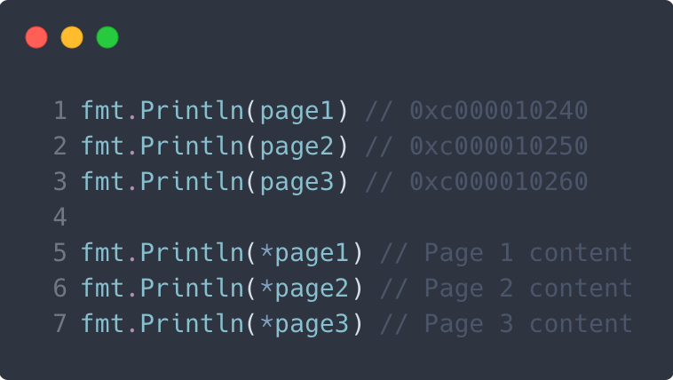
Pointer Analogy
Think of it as a book, the & operand would tell us the page number, and the * operand the contents of the page.
Notes:
When using the * operand we call that action as dereferencing.

Slide 12
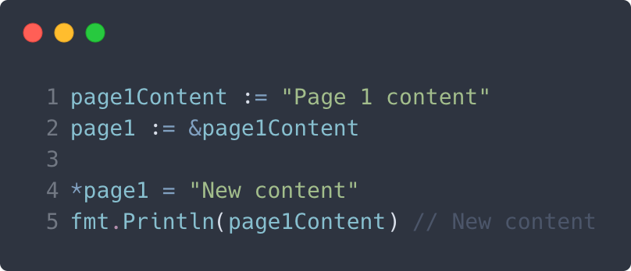
Using pointers
We can modify the value of the variable a pointer is pointing to.
Pro gamer note:
The zero value of a pointer is nil.
Notes:
We have to be careful when doing this, if we derefence a nil pointer then the program will explode.

Slide 13
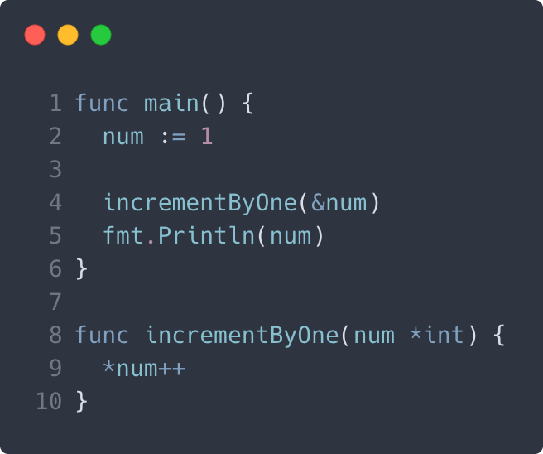
Using pointers
We can pass by reference to other functions and modify the actual value we’re pointing to.
Pro gamer note:
If we dereference a nil pointer, the program will panic, be careful!
Notes:
We have to be careful when doing this, if we dereference a nil pointer then the program will explode.

Slide 14
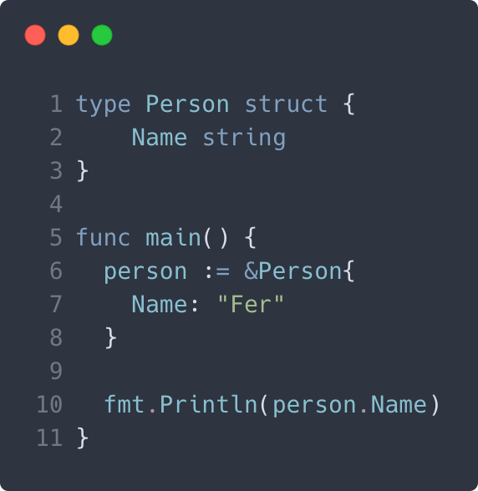
Structs & pointers
It’s very common to use pointers to structs, besides using just the value of the struct.
Pro gamer note:
Go automatically dereferences the pointer when we call a struct property or method.
Notes:
We can understand this better when looking at methods

Slide 15
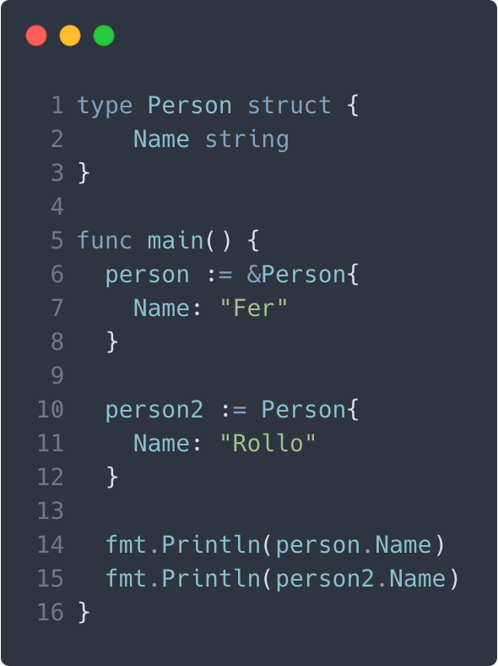

Structs & pointers
When using structs…
Should we declare a pointer?
Should we use it as a value?
Notes:
We can understand this better when looking at methods

Slide 16
Methods

Slide 17
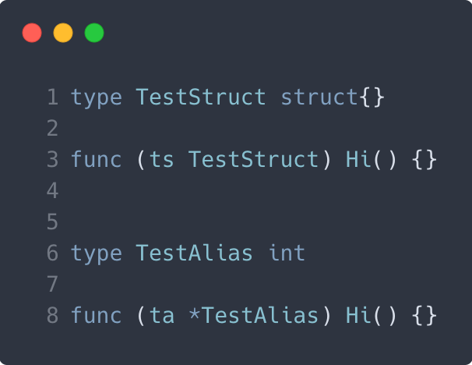
What are methods? Are those functions?
Well, yeah. The only difference is that methods have a receiver argument.
This receiver can be any data type, or pointer to any data type, as long as it has an alias and it’s not an interface.
Notes:
We usually name the receiver with one letter, having some relation with its type

Slide 18
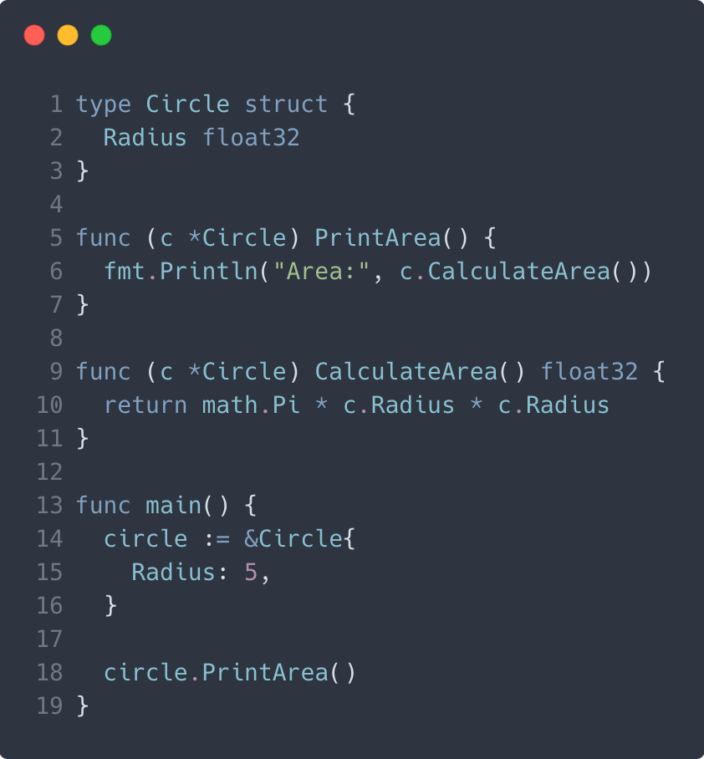
What can we do with methods?
We can access the receiver properties and methods inside the function!
Pro gamer note:
Receiver <-> this/self
Notes:
Unlike this, Go does require you to reference the receiver to access its properties

Slide 19
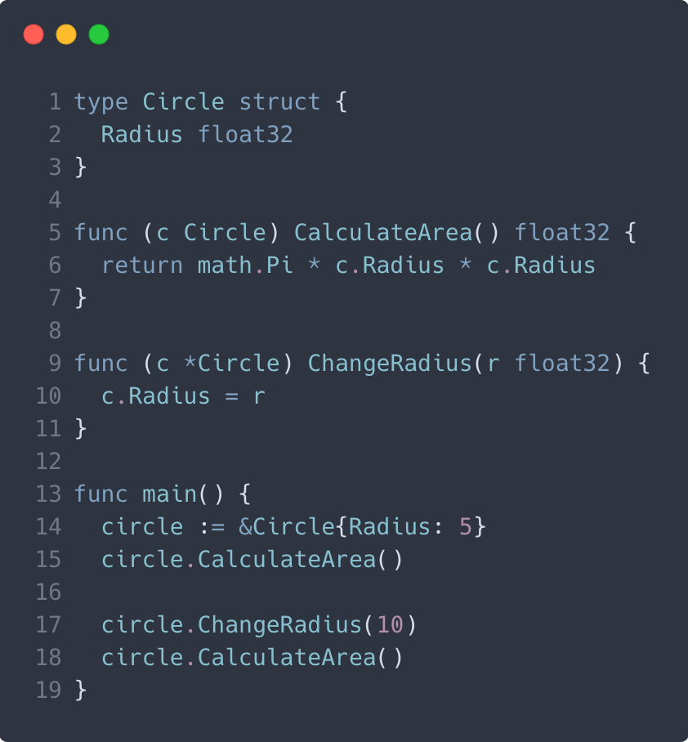
Pointer or value receiver?
That depends if we plan to modify the struct properties or not.
Notes:
Unlike this, Go does require you to reference the receiver to access its properties

Slide 20
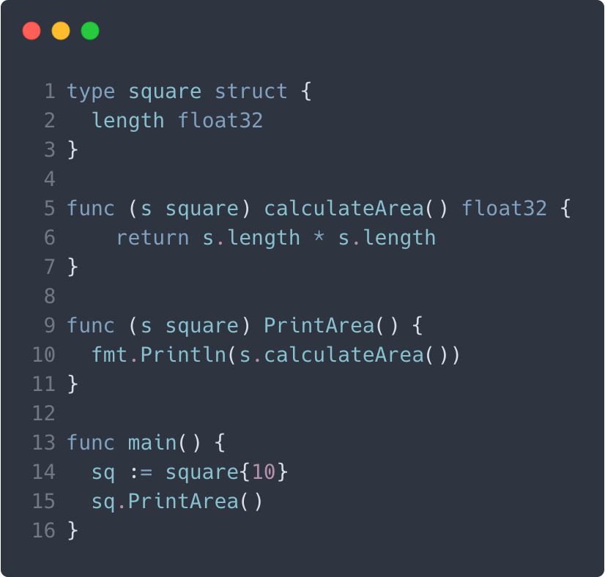

Exporting methods
You can choose whether to export or not export methods, this is a way of encapsulating behaviour.
Would you export a method/property of an unexported struct?
Notes:
Unlike this, Go does require you to reference the receiver to access its properties
Although, it doesn’t make much sense to export methods of an unexported struct... But you can actually do it and call the functions in other packages!

Slide 21
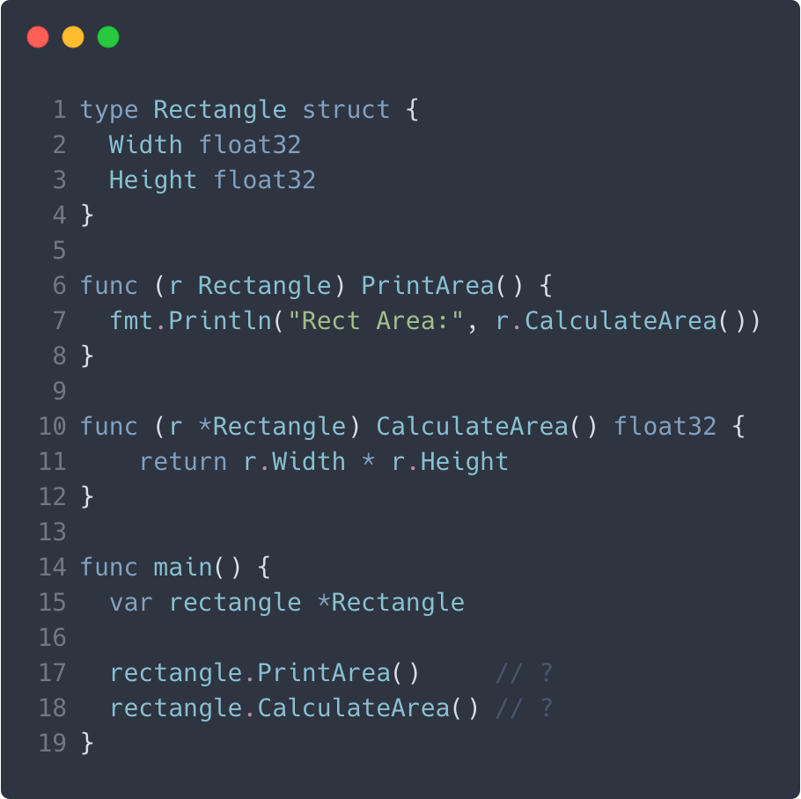

Let’s see a tricky scenario
Think about this for a sec…
Can we call a method from a nil receiver?
Notes:
Unlike this, Go does require you to reference the receiver to access its properties

Slide 22
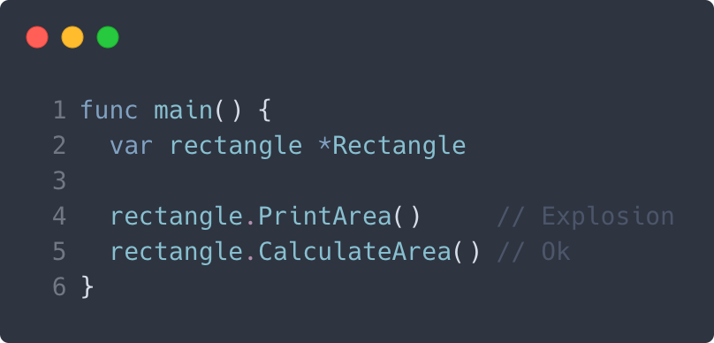
Yes we can, but...
It is possible to call a method from a nil receiver, as long as the receiver is a pointer.
If it expects a value, then the receiver will try to extract the values from the instance and, since it’s nil, the program will explode.
Notes:
Unlike this, Go does require you to reference the receiver to access its properties

Slide 23

Why using methods?
We can do everything a function can with methods. We can pass a struct or pointer to a function already, so why change?
The answer is because we can’t use the power of interfaces without methods!
Notes:
Unlike this, Go does require you to reference the receiver to access its properties

Slide 24
Interfaces

Slide 25
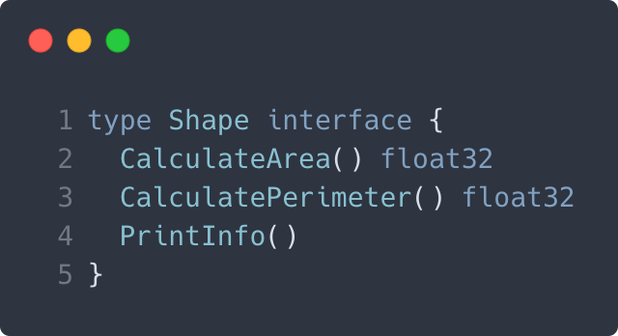
Inter-what?
An interface is a collection of method signatures that a Type can implement.
An interface defines the behavior of the Type.
Pro gamer note:
An interface is also a data type

Slide 26
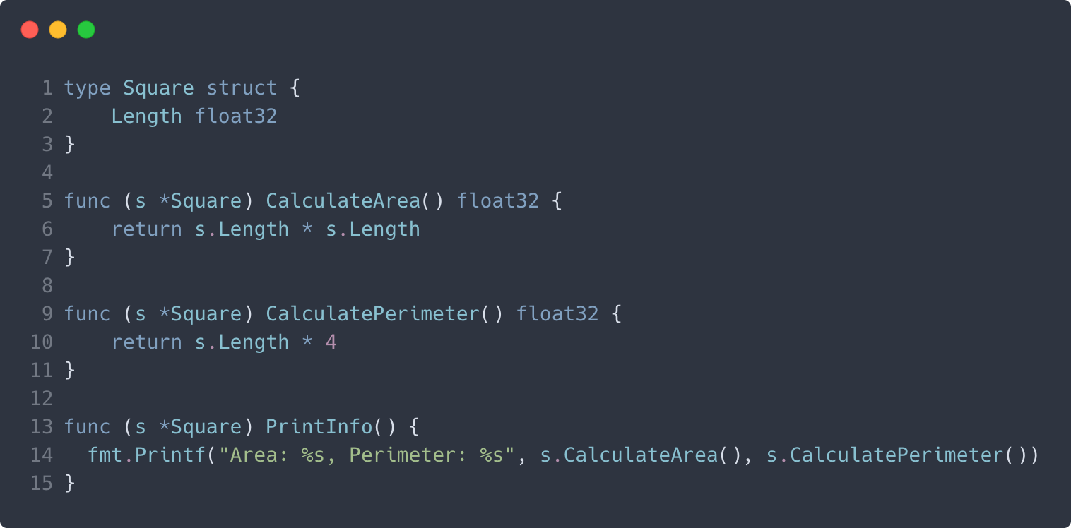
How to implement it?
Any Type that implements the methods defined by the interface implicitly becomes that interface.
Pro gamer note:
Structs don’t know if they’re implementing an interface or not.

Slide 27
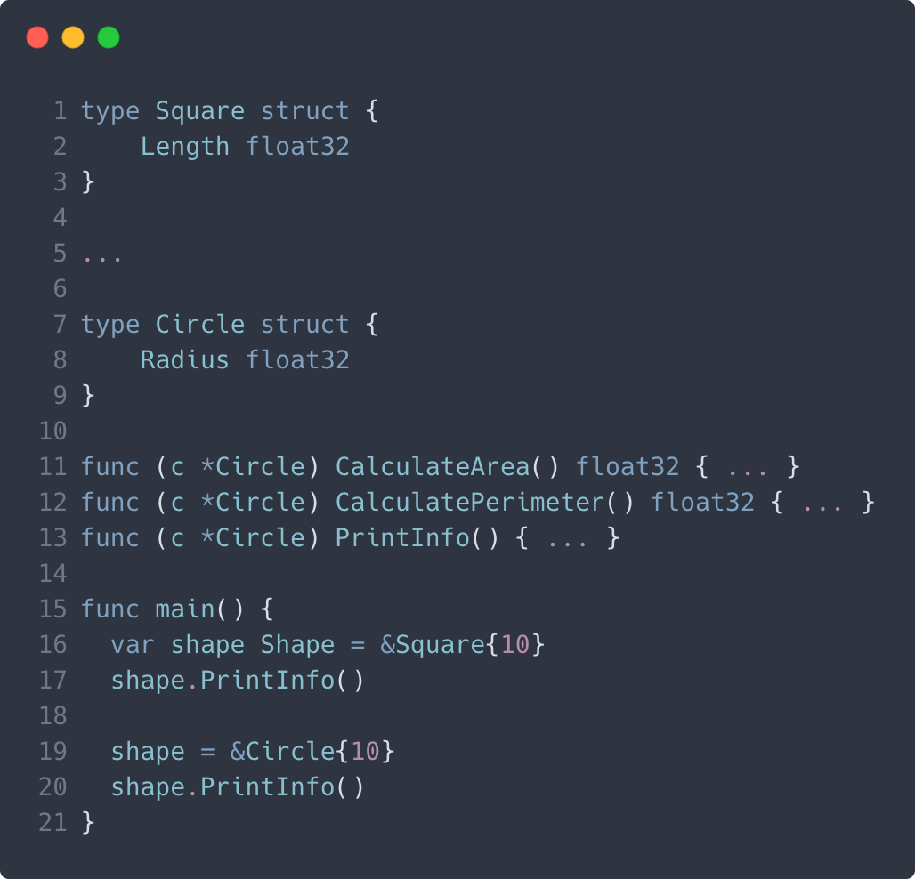
How to use them?
Using interfaces allows us to do things very similar to polymorphism.

Slide 28
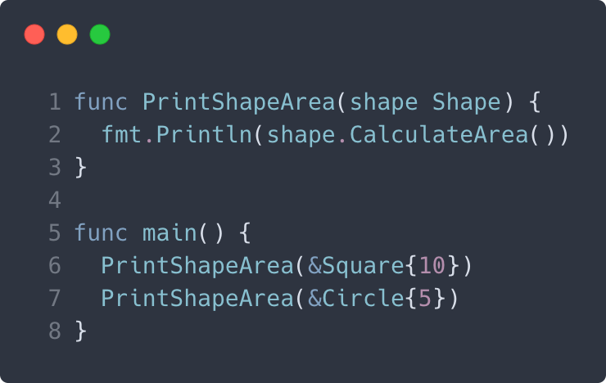
How to use them?
Since interfaces are data types, when can use them as function arguments as well.

Slide 29
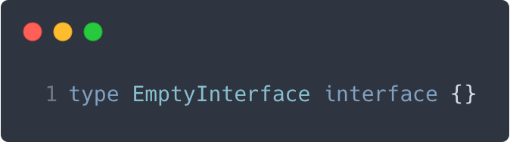
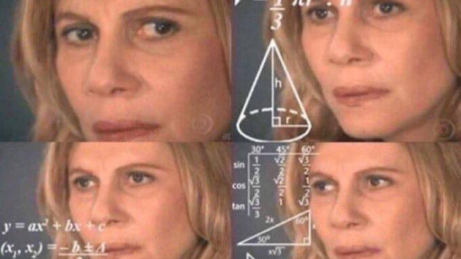
The empty interface
Think about this for a sec...
If we have an empty interface, how do we implement it if there are no methods to implement?

Slide 30
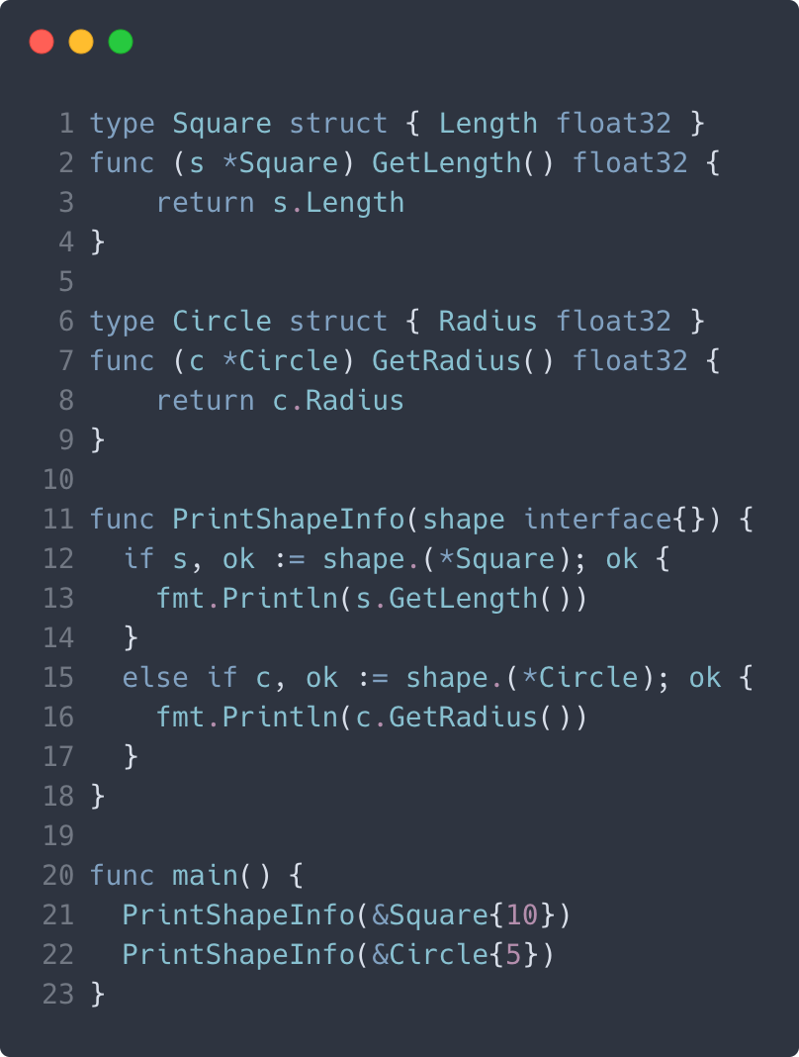
The empty interface
Well, in this case any Type already implements the empty interface!
Until we finally get generics on the language (on year 3021), this is the way we can represent any Type.
Pro gamer note:
We can also return empty interfaces from functions

Slide 31
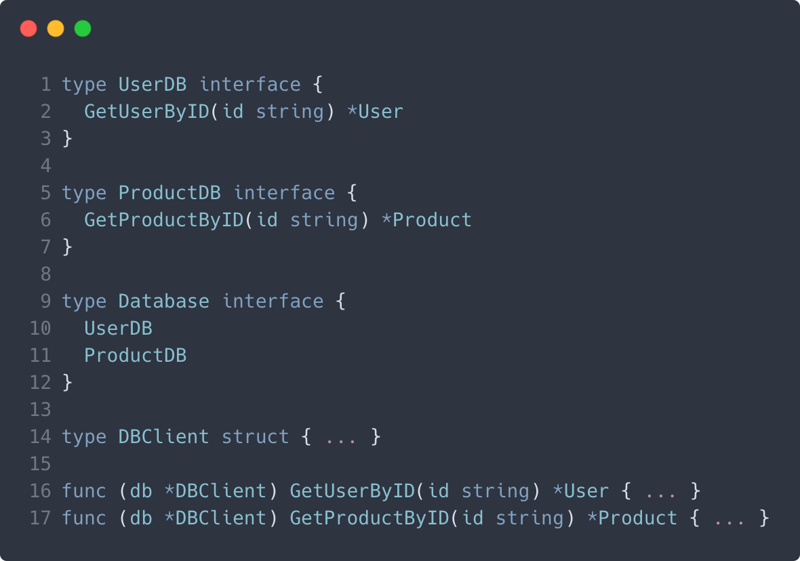
Composite interfaces
We can define composite interfaces by doing the following.

Slide 32

Best practices
Since interfaces define behavior, whenever it makes sense, add an ‘er’ suffix to the interface name, for example:
ExternalAPIService -> ExternalAPICaller
Define your interfaces where you need them, not where you implement them (and only with the methods you actually need).
Pro gamer note:
These are not strict rules, use what makes sense to your requirements

Slide 33

Common uses
Interfaces and polymorphism are crucial when it comes to testing and when wanting to do dependency injection.
We can abstract logic by using the empty interface.
Interfaces helps us decouple dependencies from other packages.

Slide 34
Packages

Slide 35
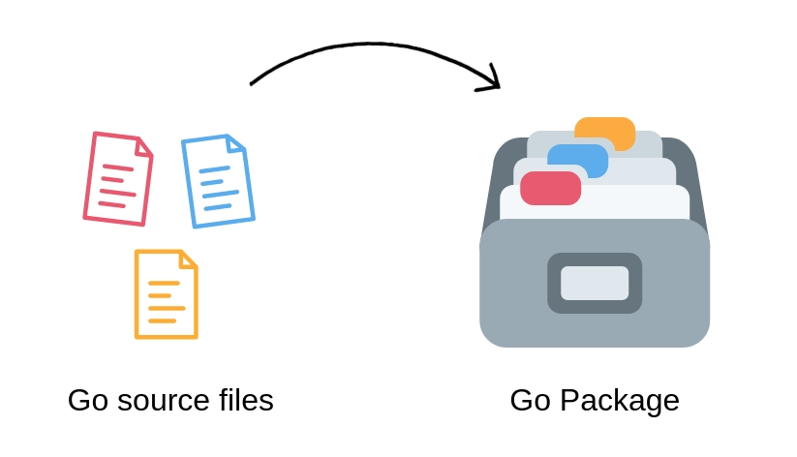
Packages huh?
If you come from other languages like JS, Java, C#... then packages will sound familiar.
They’re basically a way to encapsulate and separate similar code into their own... well, package/namespace/module/etc.
Any piece of Go code belongs to a package.

Slide 36
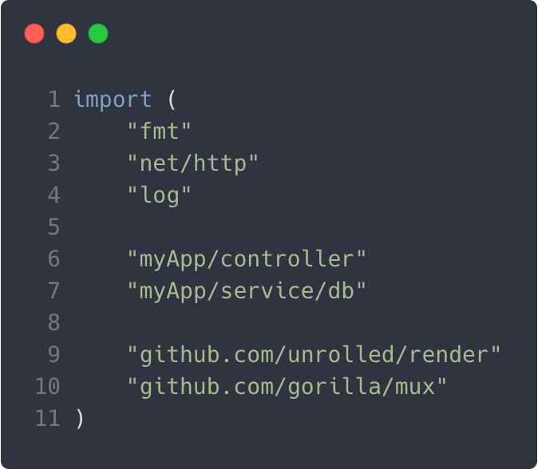
Packages we can use
There are basically 3 types of packages we can use:
Packages that Go comes with
Internal packages
3rd party packages

Slide 37
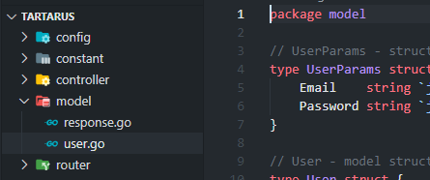
Creating our own packages
To create a package we just need to create a folder and put some code in it, just name the package the same as your folder and it should be good to Go (haha get it? GO).

Slide 38
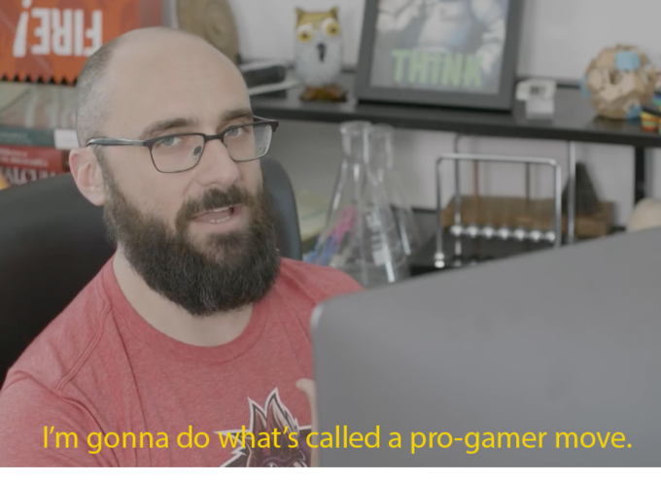
Using our own packages
It’s pretty easy to use our own packages nowadays with the help of Go Modules.
Let’s head over to the editor, shall we?

Slide 39

Using 3rd party packages
Be careful when using 3rd party libraries, specially open source ones.
We actually need to have the library downloaded in our machine to use them, we can use one of the tools Go already provides for this.
To the editor again, yay!

Slide 40
Challenge

Slide 41
The challenge
You have 30 minutes to finish the challenge. You are going to put in practice what we learned in this workshop. Clone the following repo: https://github.com/RolloCasanova/bootcamp-workshop-w3
Good luck!

Slide 42
Recap - Q&A

